Slide 1
Analysis of Stroke Patients
By Nicholas Orgel

Slide 2
Stakeholder
The dataset that was used for this presentation is patient data and their likelihood of having a stroke, based on different factors such as: age, marital status, history of heart disease and hypertension, smoking status, etc.
The stakeholder in this instance would be a hospital or medical facility that is testing the risk possibilities of a patient having a stroke at some point in their life.

Slide 3
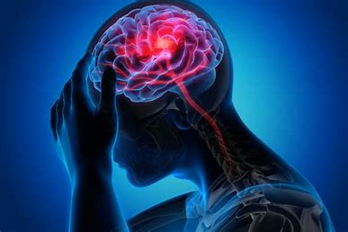
What is a Stroke?
Image Link

Slide 4
What is a stroke?
An ischemic stroke occurs when the blood supply to part of the brain is interrupted or reduced, preventing brain tissue from getting oxygen and nutrients. Brain cells begin to die in minutes.
Link | MayoClinic.org

Slide 5
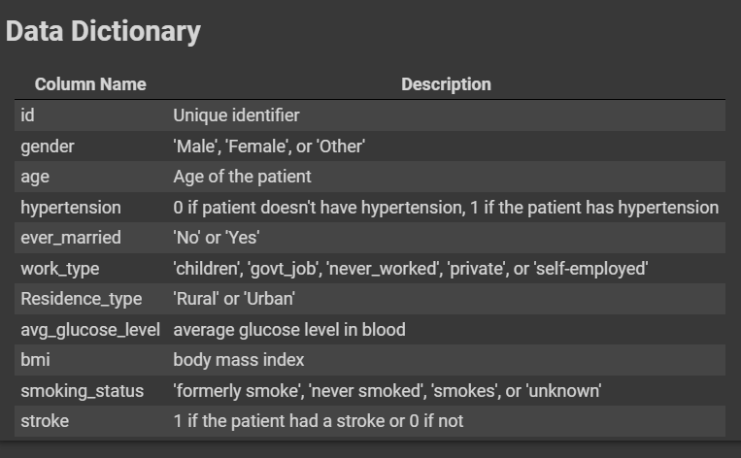
What kind of problem is this?
With the data that is present and the target for this problem being whether a patient has had a stroke or not being binary (either 1 for yes the patient has had a stroke, or 0 for no); this is a classification problem.

Slide 6
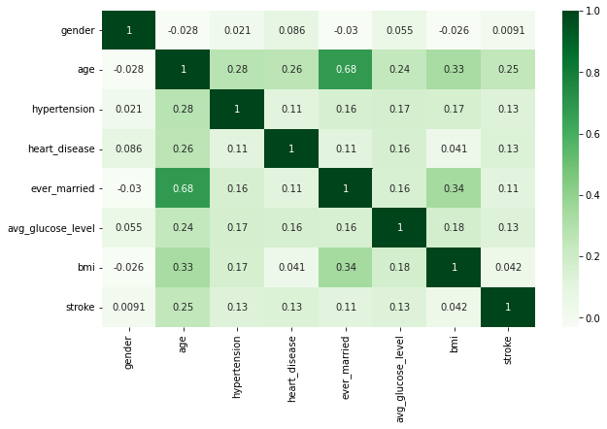
Correlation Strength
Pictured to the left is a correlation heatmap, which finds the best correlation of different features in the dataset when compared to one another.
The darker the shade of green a box is, the stronger the correlation is.
__________________________________________
The features with the strongest correlation are:
A patient’s age + marital status (ever_married)
Body Mass Index (BMI) + marital status
A patient’s age + whether they have had a stroke or not.

Slide 7
Correlation Visualizations

Slide 8
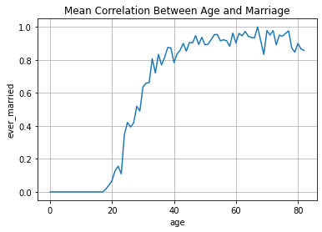
Age & Marriage Correlation
- Many patients start to get married in their 20's and 30's.
- Nearly half of the patients in the data that are present are married by the time they reach 30 years of age.
- By age 65, the average percentage of patients who are married is close to 100%, but there is soon a slight decrease at age 70.
- The decrease goes to a percentage around 85% where one can assume that people in this age group no longer wish to be married or have never been married at all.

Slide 9
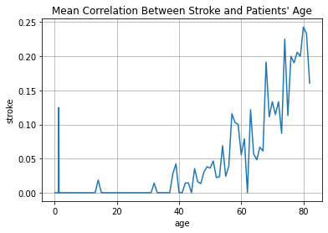
Age & Stroke Correlation
- As the older a person gets their likelihood of having a stroke increases.
- However, by early 60 years of age, the average percentage drops to almost 0%, the assumption here being that by this time patients are more considerate about their overall health for a small time.
- The most significant age where someone is likely to have a stroke is around age 80 with a 25% chance probability.
- While the line plot gives the interpretation that infants are at high risk of a stroke, this is only from 13 values that are present in the age column that are less than 20 years of age. It has no significant impact on the risk at early developmental stages.

Slide 10
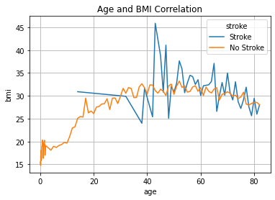
Age & BMI Correlation
The line where patients’ have had a stroke is BLUE
The line where patients’ have not had a stroke is ORANGE
- The line plot shows that when comparing patient's age and bmi and the likelihood of having a stroke; there seems to be no major significance as only a small minority of patients the age groups of 60-80 have had a stroke.

Slide 11
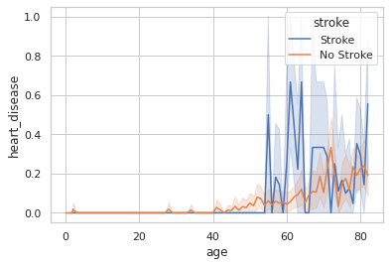
Age & Heart Disease Correlation
There seems to be no major impact that heart disease has on a patient's' age and their likelihood of having a stroke.

Slide 12
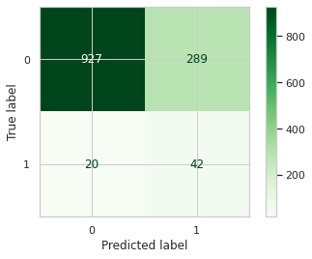
Model Testing And Production Determination
Tuned ADABoost Model
Various types of classification models were tested and tuned, but ultimately I decided to use the Tuned ADABoost Model because it had the lowest amount of false positives and false negatives.
False Positives in this instance would be patients that were labeled to have had a stroke, but they really did not.
False Negatives would be where patients that were labeled to have not had a stroke, but they really did.
False Positives are highlighted in the red circle.
False Negatives are highlighted in the blue circle.

Slide 13
Recommendations
While every model had False Positives and False Negatives, the Tuned AdaBoost Model had the lowest number. This would equate to less chance of error, but not erasing the possibility outright.
This model would be recommended to use for production to the stakeholder to help patients determine actions that would be better for their overall health and to decrease the chances of having a stroke as low as possible.

